Slide 1
Your Company Logo

Slide 2
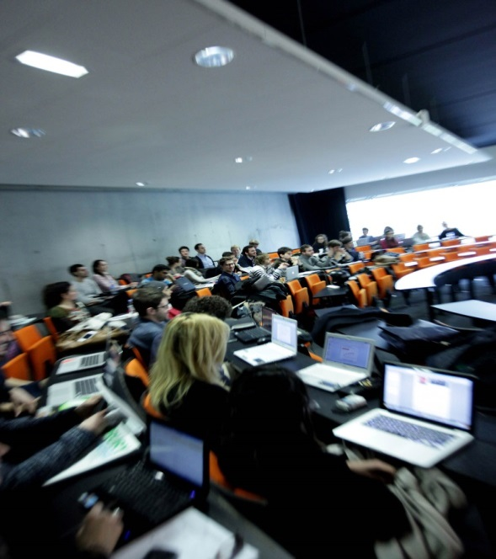

[Notes for managers]
Deadline for identification of managers and topic: November 27th 2023
Deadline for validation of the Brief: December 19th 2023
(pierre-jean.barlatier@edhec.edu / franck.debane@edhec.com)
This detailed brief template is only provided as an indication to help you prepare the elements related to your case (you can therefore add/change/delete chapters)
The purpose of this document is to give students the keys to start their work in a specific and relevant framework
All information must be provided in English.

Slide 3
Context
Business unit/service presentation
  Key business objective for the coming year
Current customers
Products, offers and services
Brand history and values
[explain the brand values that the students need to incoporate in their thinking]
Company culture

Slide 4
The Challenge :
xxxxxxxxxxxxx [start with an active verb, ex: Design, Define, Conceive, Boost, Develop, etc …]
What business problem are you trying to solve?
  Is it a business problem, a customer problem, a technical problem, a marketing problem or something else?
Do you have any specific customer segment in mind?
What are the constraints the innovation need to take into consideration?

Slide 5
Case Moodboard
Include here visuals, images representing the case « universe » to inspire students
Ex: customer personas, competing products, etc…

Slide 6
Where to start?
What information/research should the teams read/analyze to get started?
Who should they be talking to?
[Include presentations to read, websites/stores to visit, competitors, trends/benchmarks to analyze, all necessary background info to get started…]
[The students will start with an « Inspiration » phase during which they will start interacting with potential customers.
Please give them some clues on how to locate them especially if access is difficult]

Slide 7
Contact
[Include mails of the managers in charge so that the students can contact them]
[You will have a midterm confcall with them (20 min max. per team) in February timing to be confirmed) ]
[Then you can decide and let them know how/if you would like to interact further with them before the d-day in March]

